Slide 1

Introduction To Machine Learning

Slide 2
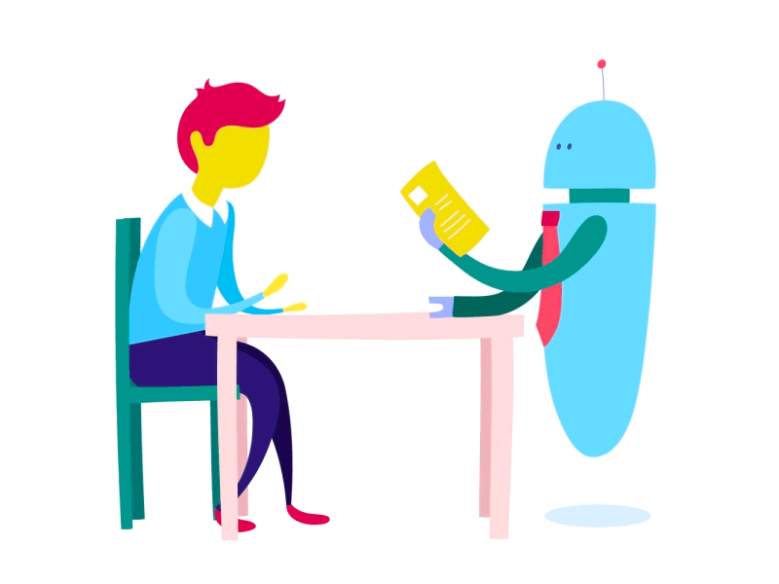
What is Machine Learning?
Machine learning is the science that allows computers to learn directly from data through examples and experience.
Notes:
Machine learning is the process wherein machines learn by examples ,experience and discovery through DATA.

Slide 3

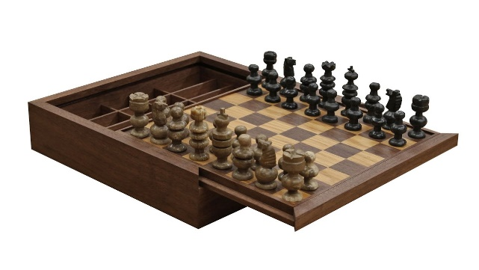



Analogy to Machine learning
Hey, take this chessboard, Rule book and 100 best games.
Task: To learn to play chess
Notes:
Suppose a scientist wants to teach a robot how to play chess. He only provides it with the basic rule book, a chessboard, and the data for 100 best chess games.

Slide 4
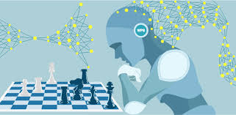
What is Machine Learning?
Sometime later….
Learned enough to play chess with Vishwanathan Anand!
Notes:
In this case – the robot is the machine, past game records are the data and chess rule book is the algorithm. We only fed a basic algorithm to the machine and some data to learn from. The machine sipped through the data, understood which moves improved the chances of winning the game and added those moves to the algorithm. This is the concept of machine learning.

Slide 5
Journey of Machine learning

Slide 6

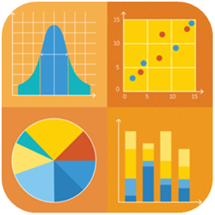
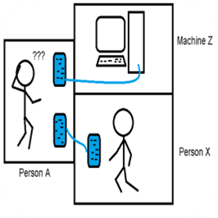
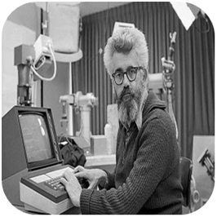
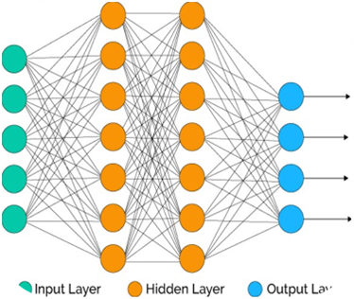
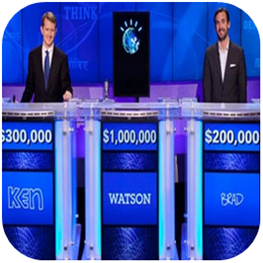
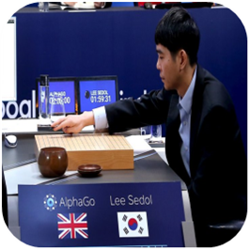
Timeline of Machine learning
David Rumelhart introduces Neural network models for machine learning
IBM’s Watson won a game of the US quiz show Jeopardy against two of its champions.
AlphaGo beats the world champion at Go
The Turing Test
The term ‘Artificial intelligence’ coined by John McCarthy
Deep Blue defeats reigning world chess champion
Development of Statistical methods
1800
18 th century
1950
1956
1986
1997
2011
2016
2018
Statistics
Computers
AI
Neural networks
IBM Watson triumphs over humans
AlphaGo beats world champion

Slide 7
If Machine learning has been there for last few decades, why is it popular now?

Slide 8
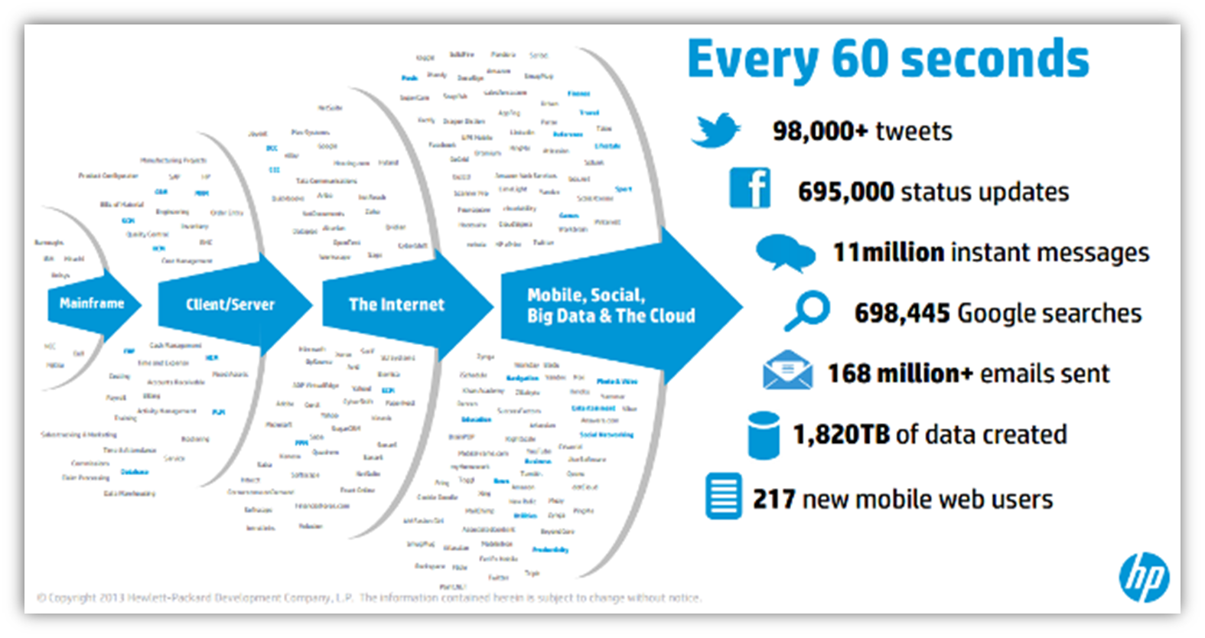
Why is Machine Learning a rage now : Data Availability
Amount of digital data being generated is huge
07

Slide 9
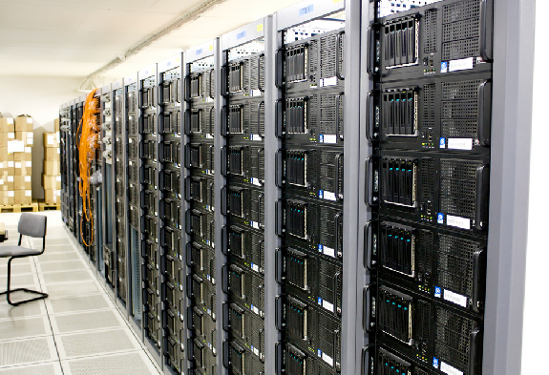
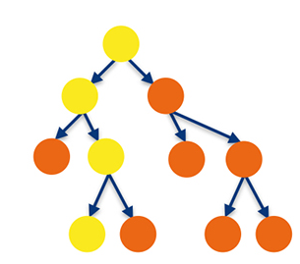
Why is Machine Learning a rage now : Computational power
Processors reliably store and analyze massive data
Building complex Machine Learning models with billions of parameters are now possible
07
Notes:
Current hardware has the capability to reliably store and analyse the massive data and perform massive amount of computations in a reasonable amount of time.

Slide 10
Let’s compare between Traditional programming and Machine Learning..

Slide 11
Pros and Cons of Traditional programming
Pros
Easier to read and understand
Error analysis is simpler
Cons
Rule based systems
Fails in many outside test scenarios
Hard coding becomes difficult for humongous data
Notes:
Machine learning is the process wherein machines learn by examples ,experience and discovery through DATA.

Slide 12
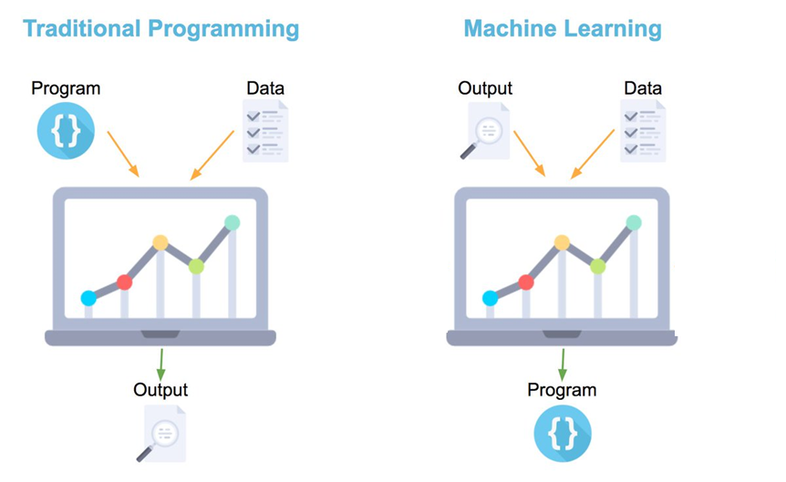
Traditional Programming vs Machine Learning
07

Slide 13

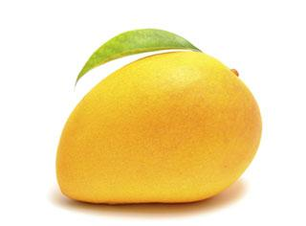
Let’s go for mango shopping in the traditional way…

Slide 14
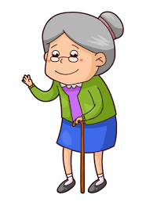
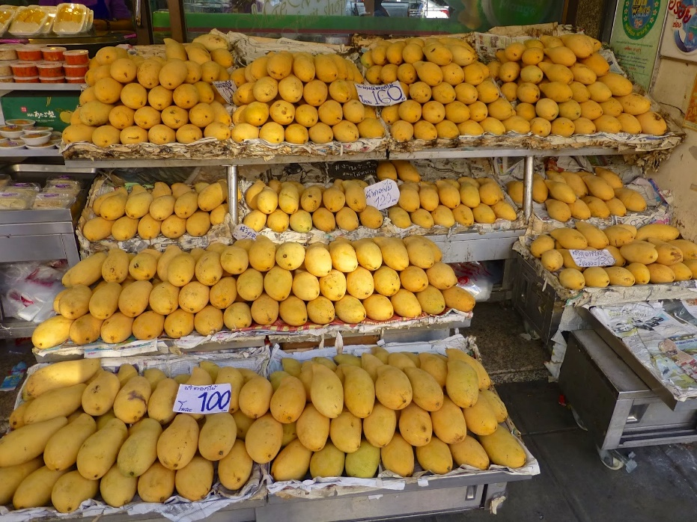
Choosing the right mango for the first time
Rule 1: Bright yellow mangoes are sweeter than pale yellow ones.
John visits the fruit shop, and buys mangoes that are bright yellow in color remembering his grandma's instruction.
07

Slide 15

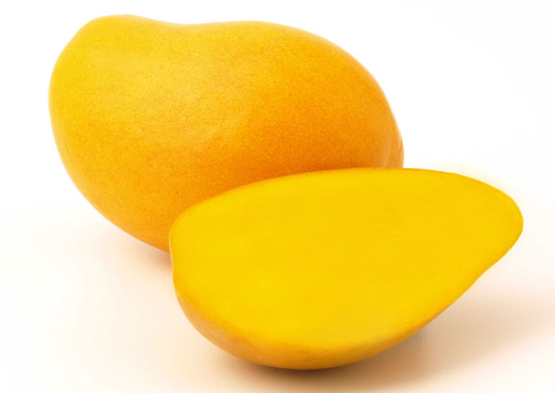
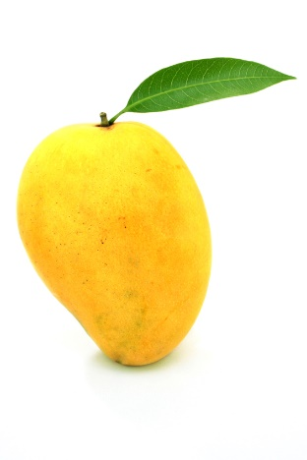
Rule changes as Grandma’s advice is insufficient
John reaches home after tasting realizes that not all bright yellow mangoes are sweet. He concludes
Rule 2: big bright yellow mangoes are sweeter than small bright yellow mangoes.
sweeter than
Big mangoes
Small mangoes
07

Slide 16
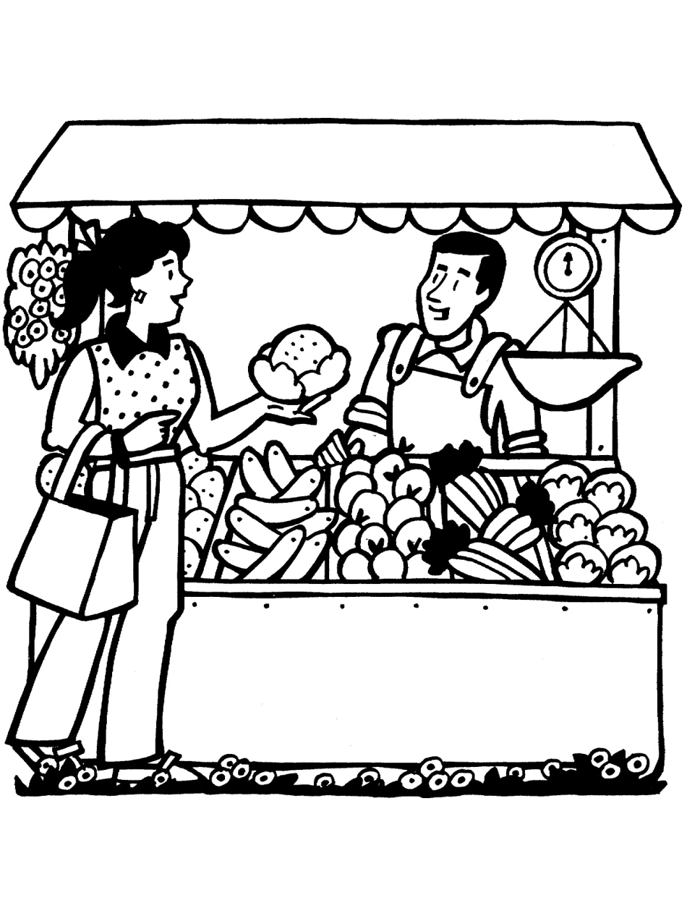
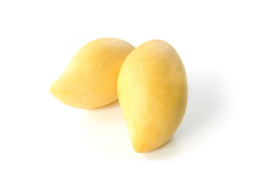
Choosing the right mango for the next time
He recalls from his previous experience and is now confident to buy mangoes. But alas he finds a different vendor this time who imports his mangoes from a different part of the country .
He Tastes a mango of each kind from this vendor, and realizes that
Rule 3: small, pale yellow ones are in fact the sweetest of all.
07

Slide 17
Buying juicy mangoes
John’s cousin comes home and he wants juicy mangoes.
John tastes all mangoes once again and realizes
Rule 4:Softer mangoes are more juicy.
07

Slide 18
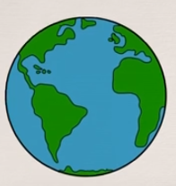
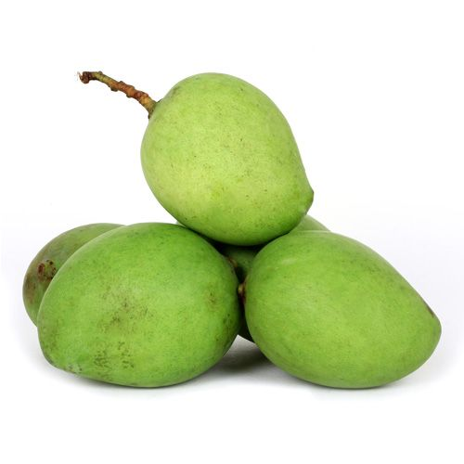
Buying mangoes from a different country
John’s goes to a different country and purchases mangoes.
John tastes all mangoes once again and realizes
Rule 5:Green mangoes are tastier than the yellow ones.
07

Slide 19

Let’s create a program to buy the sweetest mango
If we were to buy the perfect mango we create a program that follows the Rules that John observed in each scenario.
if (color is bright yellow and size is big and sold by favorite vendor): mango is sweet.
if (soft): mango is juicy.
And so on…
Rules will have to be manually modified for every different situation.
As the rules increase program becomes complicated.
07

Slide 20
Machine learning comes to our rescue…
Let’s buy mangoes the machine learning way…

Slide 21
How does Machine Learning work?
In machine learning, Data is fed into the system and rules are extracted from the data.
 | Color | Size | Shape | Which vendor | Which part of the country | Taste
Mango 1 | Yellow | Big | Oval | Local | Amritsar | Ripe
Mango 2 | Green | Small | Round | Foreign | England | Sweet
Mango 3 | Yellow | Small | Round | Local | Amritsar | Juicy
07

Slide 22
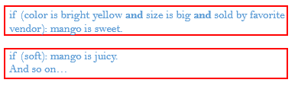
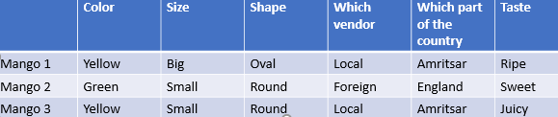
How does Machine Learning work?
Model
Feed Data
Produces a model with same rules automatically rather than
manually
Machine learning algorithm
New Data
Model
Predicts sweet, ripe or juicy
07

Slide 23
Top Machine learning terminologies to start with…

Slide 24
Term 1: Features
The number of distinct traits that can be used to describe each item in a quantitative manner.
Features-Distinct traits that decide taste of a mango
Output Feature variable- Taste of a mango
 | Color | Size | Shape | Which vendor | Which part of the country | Taste
Mango 1 | Yellow | Big | Oval | Local | Amritsar | Ripe
Mango 2 | Green | Small | Round | Foreign | England | Sweet
Mango 3 | Yellow | Small | Round | Local | Amritsar | Juicy

Slide 25





Term 2: Samples
A sample is an item to process. For instance, it could be an document, picture, sound, or a raw database.

Slide 26
Term 3: Feature vector
A feature vector is an n-dimensional vector of numerical features that represent some object
.
 | Color | Size | Shape | Which vendor | Which part of the country | Taste
Mango 1 | Yellow | Big | Oval | Local | Amritsar | Ripe
Mango 2 | Green | Small | Round | Foreign | England | Sweet
Mango 3 | Yellow | Small | Round | Local | Amritsar | Juicy
Feature vector- [Yellow,Big,Oval,Local,Amritsar,Ripe]

Slide 27
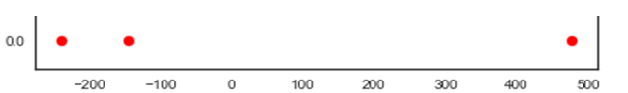
Term 4: Feature Extraction
Preparation of feature vector
Transforms the data from high-dimensional space to a space of fewer dimensions.
.
 | Color | Size | Shape | Which vendor | Which part of the country
Mango 1 | Yellow | Big | Oval | Local | Amritsar
Mango 2 | Green | Small | Round | Foreign | England
Mango 3 | Yellow | Small | Round | Local | Amritsar
Transforming 5D to 1D
Sweet
Juicy
Ripe
Notes:
** Try to have more meaningful representation such as highlight an actual data set and show which point is which part

Slide 28
Term 5: Training set
Set of data to discover potentially predictive relationships.
.
.
Training Data
 | Color | Size | Shape | Which vendor | Which part of the country | Taste
Mango 1 | Yellow | Big | Oval | Local | Amritsar | Ripe
Mango 2 | Green | Small | Round | Foreign | England | Sweet
Mango 3 | Yellow | Small | Round | Local | Amritsar | Juicy

Slide 29
Term 6: Test set
Set of data to validate the predictive relationship
Test Data
Mango 4 | Green | Big | Oval | Foreign | England | ?
Predictions are produced using the model

Slide 30
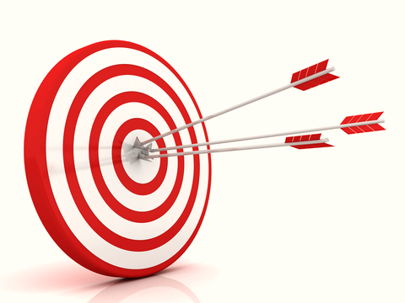
Term 7: Scoring
Evaluating the performance of a machine learning based on any statistical metric.
.
.
Accuracy

Slide 31





General Machine Learning process flow
Learning Algorithm
Training
Data
Produce a Model
Data
Test Data
Accuracy
Test Data
Test Data

Slide 32
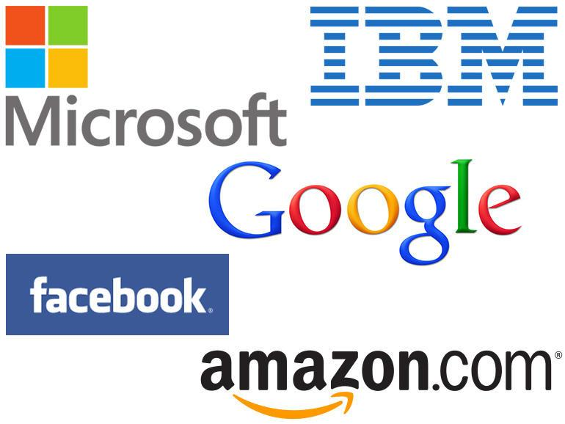



Where is Machine Learning used?
Model Data
Make Predictions
Build intelligent applications
Notes:
Machine learning is the process wherein machines learn by examples , experience and discovery through DATA.

Slide 33


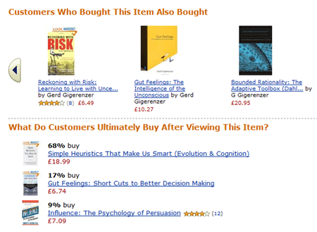
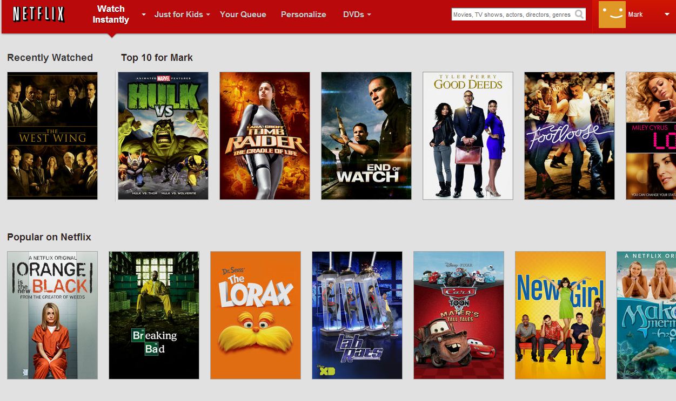
Recommendations by online retailers

Slide 34
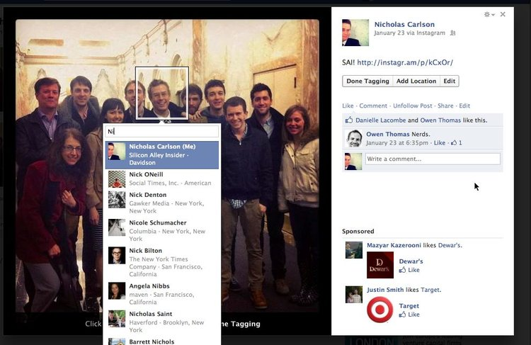


Machine learning in Social media applications
Face recognition via Photo auto tagging
DeepFace can recognize the differences in human faces with a 97.25% degree of accuracy – only 0.28% less than an actual human being.
Notes:
**How is face recognition and Friend suggestion related

Slide 35
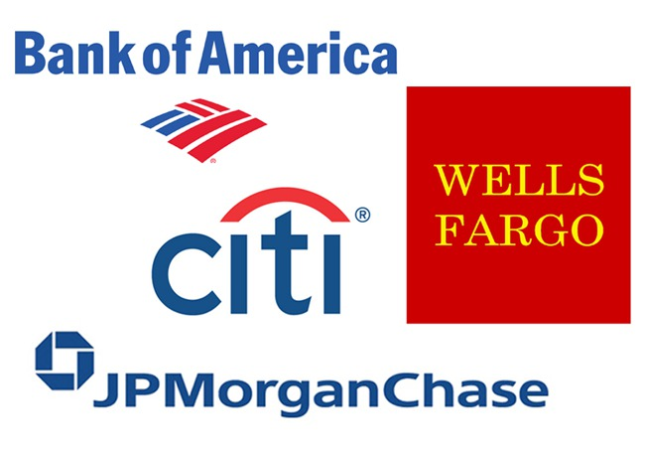
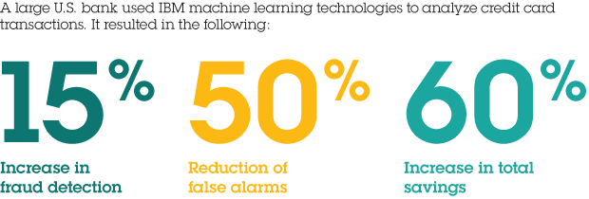
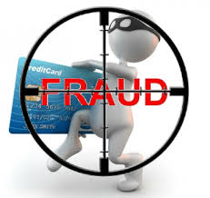

Fraud detection in banking
Notes:
Fraud detection

Slide 36
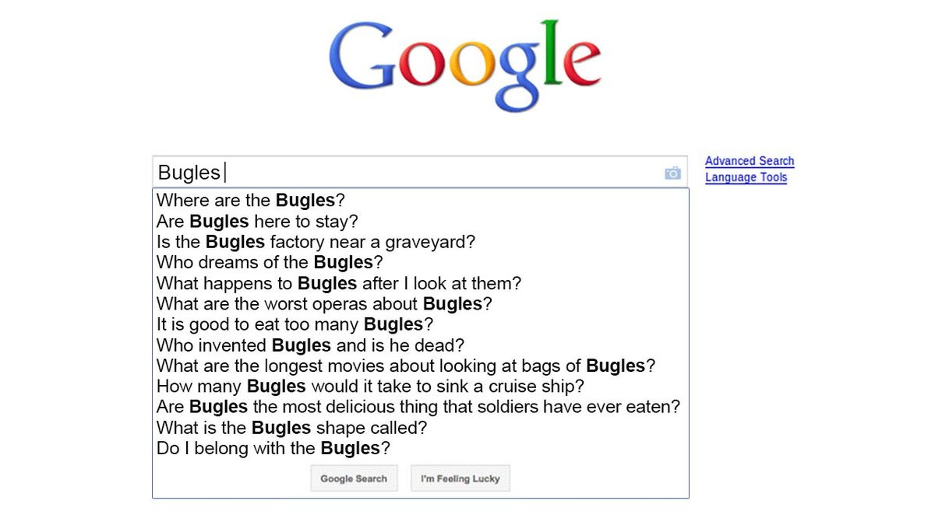

Machine Learning in Google search
In 2015, Google introduced RankBrain – a machine learning algorithm that
Works out the intent behind a user’s search
Offers user’s customized information on that particular topic.
Google searches are now done by RankBrain
Performing better than the previous rule based approach.

Slide 37
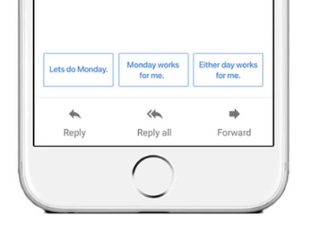

Machine Learning in Gmail
Smart reply function in Gmail helps users tackle their inbox.

Slide 38
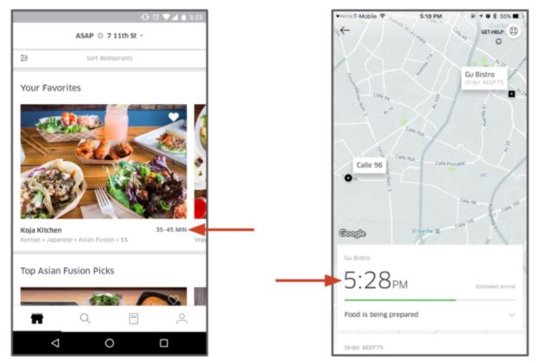
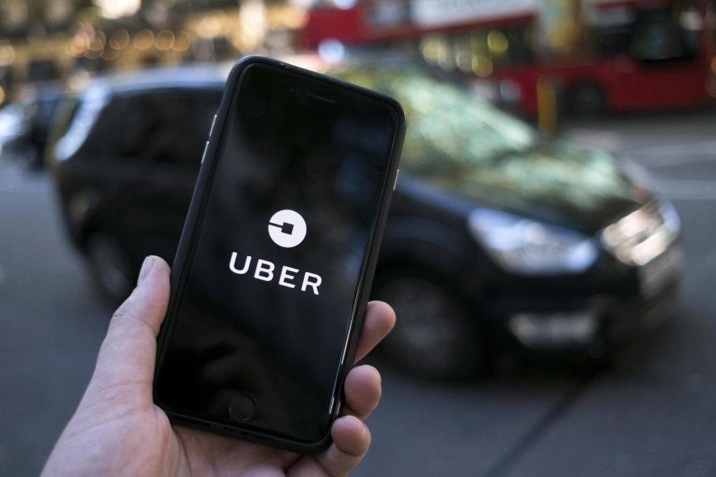
Determining arrival time in Uber using Machine learning
Uber uses its machine learning platform Michelangelo to determine arrival times, pick-up locations, and UberEATS' delivery estimations

Slide 39

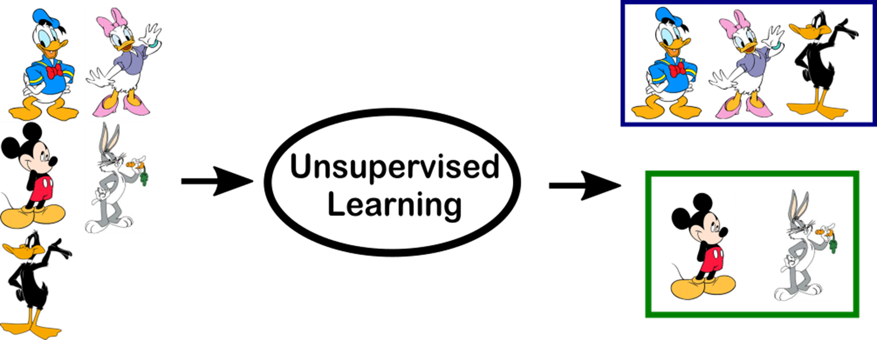
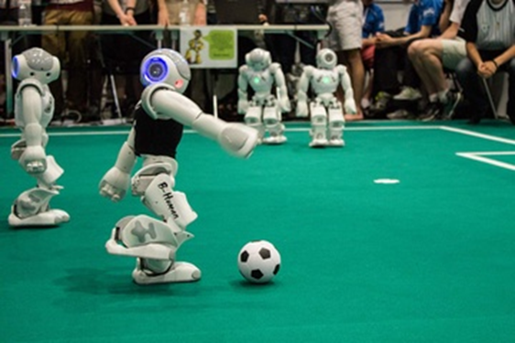
Types of Machine learning
Supervised learning
Unsupervised learning
Reinforcement learning
20

Slide 40
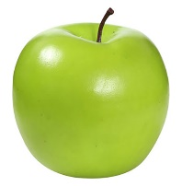
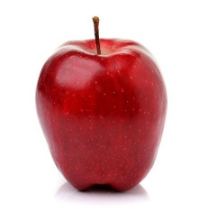

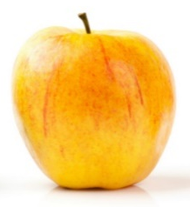
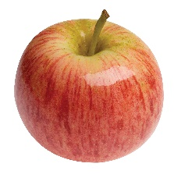

Supervised Learning: Learn from Examples
Supervised machine learning enables computers to learn from labeled data without being explicitly programmed.
Known data
Model
New response
It’s an apple
Known response
These are apples
21
New data

Slide 41
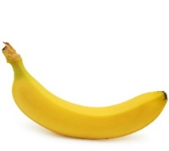

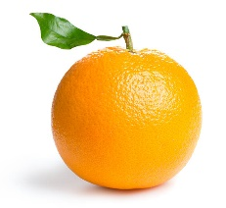
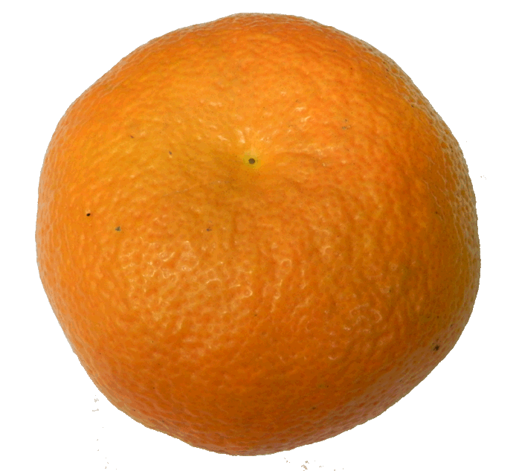
Unsupervised Learning: Uncover hidden patterns
Unsupervised learning draws inferences from data without labeled responses.
I can see patterns
Known data
Model
21

Slide 42



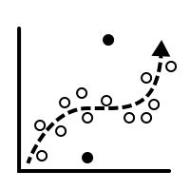
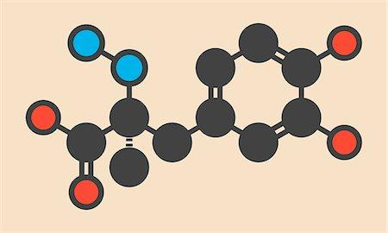
Supervised vs Unsupervised Learning
Supervised
Unsupervised
Direct Feedback
Labeled Data
No Feedback
Non-Labeled Data
Predictions as output
Find hidden structure in data

Slide 43


Reinforcement Learning: Learn by interaction with environment
Reinforcement learning develops algorithms when in direct interaction with environment and tunes itself from its mistakes using feedback.
Reinforced response
It’s a mango
Wrong! It’s an apple.
Noted!
It’s an apple!
Input
Response
Feedback
Learns
Input
21

Slide 44
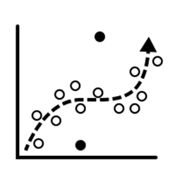
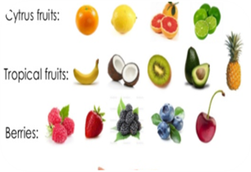

Types of problems solved through Machine learning
Regression
Classification
Clustering
22

Slide 45
Types of problems solved through Machine learning
Regression
Classification
Supervised Learning
Clustering
22

Slide 46



An example illustrating regression
A study is conducted by Stanford University in order to understand how the number of years of higher education affect the annual income of their graduated students.
Predict what would be annual income for 3 years of higher education

Slide 47





An example illustrating Classification
John wants to undertake a loan from Bank Of India in order to purchase a house. Banks conduct a thorough investigation about the person who desires to take a loan before granting one.
Will bank approve loan or not?
Yes No

Slide 48
Types of Problems solved through Machine learning
Regression
Classification
Clustering
Unsupervised Learning
22

Slide 49


Clustering topics in Google news
Categorization of news articles in Google news.
Notes:
Categorization of news articles on Google news.

Slide 50

Clustering: Selling products to the right category of customers

Slide 51
Steps in a machine learning workflow
Model Objective
Model Evaluation
Gathering Data
Train the data
Data Preparation
Choose a model
23

Slide 52



Step 1: Model objective
Classify animals into fish, mammal and bird
Fish
Bird
Mammals
23

Slide 53
Step 2: Gathering Data
Animal name | feathers | airborne | aquatic | toothed | backbone | breathes | venomous | fins | legs | tail | class type
dogfish | 0 | 0 | 1 | 1 | 1 | 0 | 0 | 1 | 0 | 1 | Fish
dolphin | 0 | 0 | 1 | 1 | 1 | 1 | 0 | 1 | 0 | 1 | Mammal
dove | 1 | 1 | 0 | 0 | 1 | 1 | 0 | 0 | 2 | 1 | Bird
duck | 1 | 1 | 1 | 0 | 1 | 1 | 0 | 0 | 2 | 1 | Bird
elephant | 0 | 0 | 0 | 0 | 1 | 1 | 0 | 0 | 4 | 1 | Mammal
flamingo | 1 | 1 | 0 | 0 | 1 | 1 | 0 | 0 | 2 | 1 | Bird
23

Slide 54
Step 3: Data Pre processing
Animal name | feathers | airborne | aquatic | toothed | backbone | breathes | venomous | fins | legs | tail | class type
dogfish | 0 | 0 | 1 | 1 | 1 | 0 | 0 | 1 | 0 | 1 | Fish
dolphin | 0 | 0 | 1 | 1 | 1 | 1 | 0 | 1 | 0 | 1 | Mammal
dove | 1 | 1 | 0 | 0 | 1 | 1 | 0 | 0 | 2 | 1 | Bird
duck | 1 | 1 | 1 | 0 | 1 | 1 | 0 | 0 | 2 | 1 | Bird
elephant | 0 | 0 | 0 | 0 | 1 | 1 | 0 | 0 | 4 | 1 | Mammal
flamingo | 1 | 1 | 0 | 0 | 1 | 1 | 0 | 0 | 2 | 1 | Bird
The features backbone, venomous and tail have same values for all animals and can thus be discarded.
23

Slide 55
Step 4: Choose a model
Animal name | feathers | airborne | aquatic | toothed | breathes | fins | legs | class type
dogfish | 0 | 0 | 1 | 1 | 0 | 1 | 0 | Fish
dolphin | 0 | 0 | 1 | 1 | 1 | 1 | 0 | Mammal
dove | 1 | 1 | 0 | 0 | 1 | 0 | 2 | Bird
duck | 1 | 1 | 1 | 0 | 1 | 0 | 2 | Bird
elephant | 0 | 0 | 0 | 0 | 1 | 0 | 4 | Mammal
flamingo | 1 | 1 | 0 | 0 | 1 | 0 | 2 | Bird
Choose any supervised learning algorithm since it has known labels.
Since labels are categorical, go for any classification algorithm.
23

Slide 56

Step 5: Train data
Animal name | feathers | airborne | aquatic | toothed | breathes | fins | legs | class type
dogfish | 0 | 0 | 1 | 1 | 0 | 1 | 0 | Fish
dolphin | 0 | 0 | 1 | 1 | 1 | 1 | 0 | Mammal
dove | 1 | 1 | 0 | 0 | 1 | 0 | 2 | Bird
duck | 1 | 1 | 1 | 0 | 1 | 0 | 2 | Bird
elephant | 0 | 0 | 0 | 0 | 1 | 0 | 4 | Mammal
flamingo | 1 | 1 | 0 | 0 | 1 | 0 | 2 | Bird
Produce a Model
Test Data
Feed training data
Training Data
23

Slide 57


Step 6: Model Evaluation
Predict unknown test data using trained model and check if predictions are correct.
Model
Predictions
Mammal
Feed test data
Bird

Slide 58

Putting it all together
25

Slide 59

Step 1: Collect Raw Data

Slide 60




Step 2: Store Raw Data
#4
Raw data means data that has not been changed since acquisition
This raw Data is stored in your storage systems.
Evaluate & critique model
#5
Present results and document
#3
Build the model
SQL Databases
#6 Deploy Model
Hadoop
NoSQL Databases
#2
Collect and Manage Data
#7
Continuous improvement process
Data warehouses
#1
Define the goal

Slide 61
Step 3: Data Pre-Processing
As a Data Scientist, a lot of your time will go in Data pre-processing. Also known as Data cleaning.
This step includes
Removing outliers
Replacing missing data
Malicious Data
Erroneous Data
Irrelevant Data
Inconsistent Data
Formatting

Slide 62

Step 3: Data Pre-Processing – contd..

Slide 63
Step 3: Data Pre-Processing - contd..
Once Data is cleaned, it needs to be processed to make it ready for use.
This stage includes
#4
Sorting
Evaluate & critique model
#3
Build the model
Classification
#6 Deploy Model
Summarization
Deploy the model to solve the problem in the real world
Deploy the model as a product to be used in real world. E.g. Amazon recommendation
#2
Collect and Manage Data
#7
Validation
Aggregation
Continuous improvement process
#1
Define the goal
Data Pre-processing(Data cleaning) is at times considered to be part of Data Processing

Slide 64

Step 3: Data Pre-Processing - contd..

Slide 65

Step 4: Exploratory Data Analysis

Slide 66

Step 4: Exploratory Data Analysis – contd..

Slide 67

Step 4: Exploratory Data Analysis – contd..

Slide 68

Step 5: Models & Algorithms
Create multiple models to solve the business problem
Compare to see which one comes closest to answering most accurately
Speed vs Accuracy: Evaluate whether a small percentage fraction improvement in accuracy is worth it

Slide 69

Step 6: Communicate visualize & report
Brainstorm with management and showcase the benefit the analysis and models bring to the plate.
Seek management’s consideration for deploying the solution to real world to help make the business more optimized and beneficial.

Slide 70

Step 7: Take action & deploy the findings in real world
Deploy the model in production
Measure the metrics
Continue improvement till business goal is achieved
For example, it could be better fraud detection rate, higher upsells through recommendation

